Slide 1
BLOCKCHAIN
Hashing in depth
Pr. TMIMI Mehdi

Slide 2
Main goal
Discuss :
Hash pointers
Some Data Structures for blockchain

Slide 3
Hash Pointer
Hash Pointer
Pointer to some object or data set
Cryptographic hash of that data or representation of that object

Slide 4
Why use ?
Regular pointers can tell you where data is located.
Hash pointers tell you that, plus let you verify that it has not been modified.

Slide 5

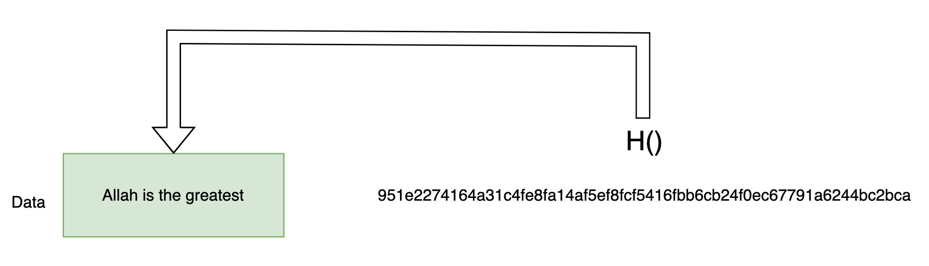
Hash Pointer
SHA-256 of 'Allah is the greatest' matches the hash pointer => All is well
NB: If there is no match between the hashes => the data has been accidentally or maliciously modified, or it may just be data corruption

Slide 6
Data structures with hash pointers
Many Data structures which use pointers/references can have their pointers/references replaced with hash pointers.
This makes them tamper-resistant versions of the 'classic' data structures

Slide 7
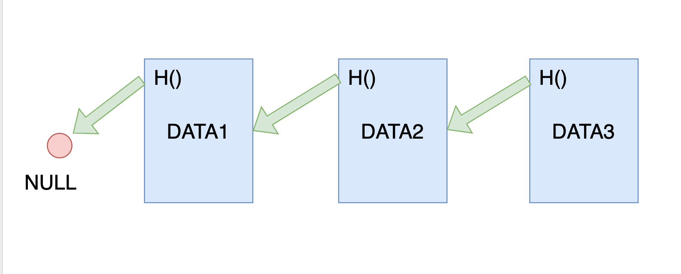
Linked List with Hash Pointers
Head of the list
If we replace those pointers with hash pointers => a basic blockchain
NB: adding the data is always on the head of the list

Slide 8
Temper-resistant
Head of the list
=> Hash pointer of previous data in the node includes both its data and the hash of the preceding node.

Slide 9
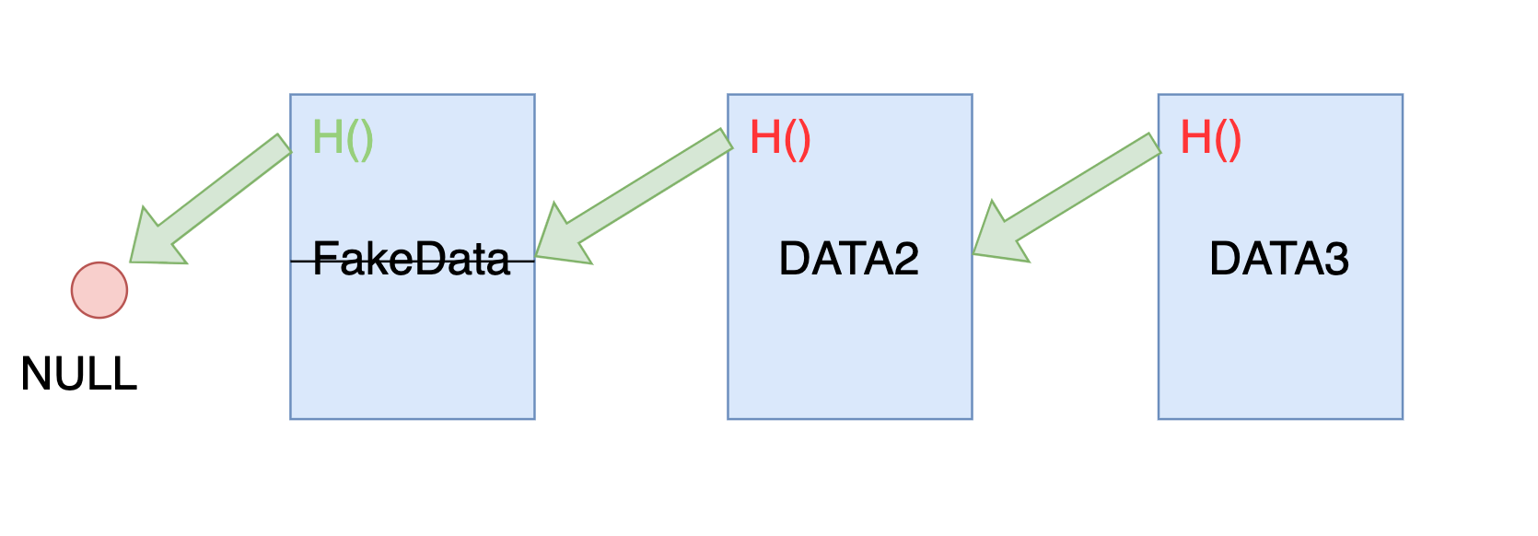
Temper-resistant
Head of the list
Strikethrough = modified data
Green = valid hash pointer
Red = invalid hash pointer

Slide 10
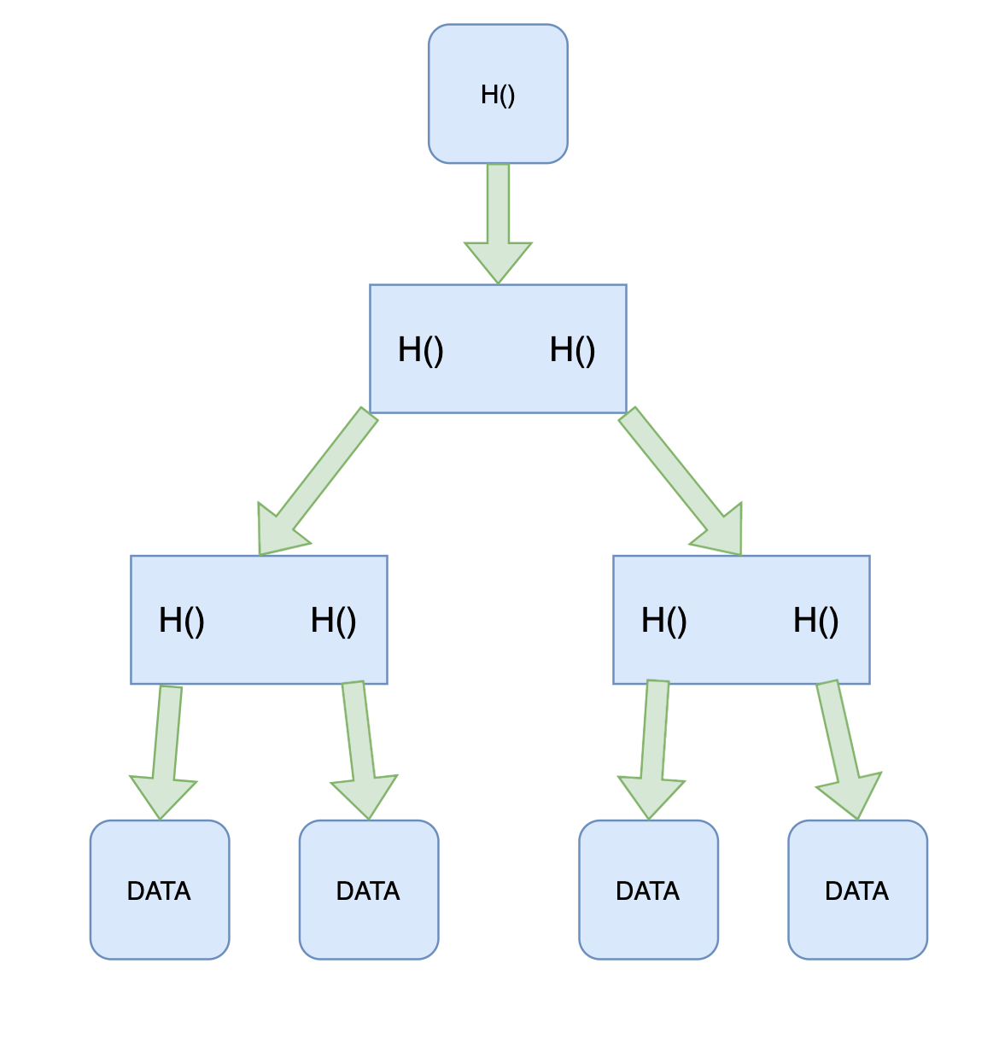
Binary Tree with Hash Pointers
Merkle root
Merkle Tree:
It's a binary tree.
Replace pointers with hash pointers.
Store data only in the leaves (it is not quite represented in the figure)

Slide 11
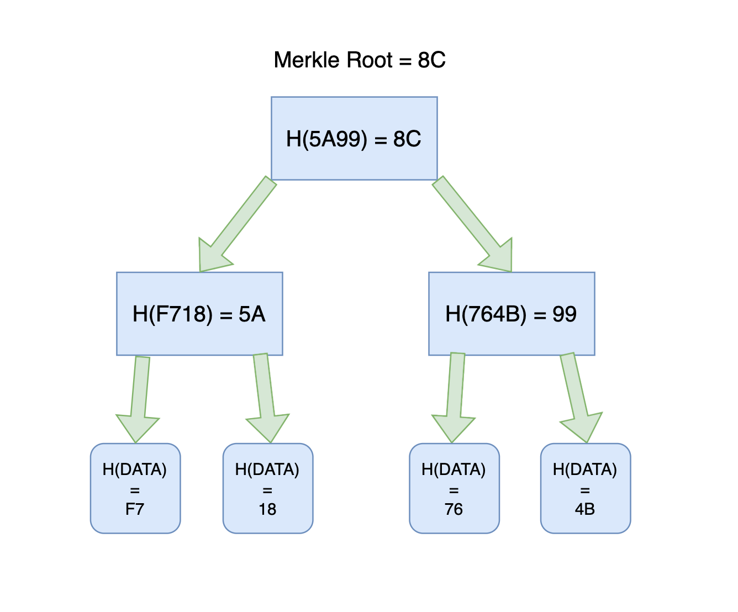
Example:
Example: using a hash function that only will return a 256 bits hash value

Slide 12
Memberships
Proving and Disproving membership in O(log n) time.
=> this requires sorted Merkle tree.
=> more efficient (less complexity) than searching in linked list

Slide 13
Why Merkle Tree
Good access time.
Can just store Merkle root to verify the entire tree.
Verify membership/ non-membership for sorted Merkle trees in O(log n) times

Slide 14
Bitcoin & Merkle Tree
The Merkle root in a block is the Merkle root of all transactions in that block.
Allows mining to be approximately equally difficult no matter how many transactions are included. => incentivize miners to add more transactions, so they get transaction fees.

Slide 15
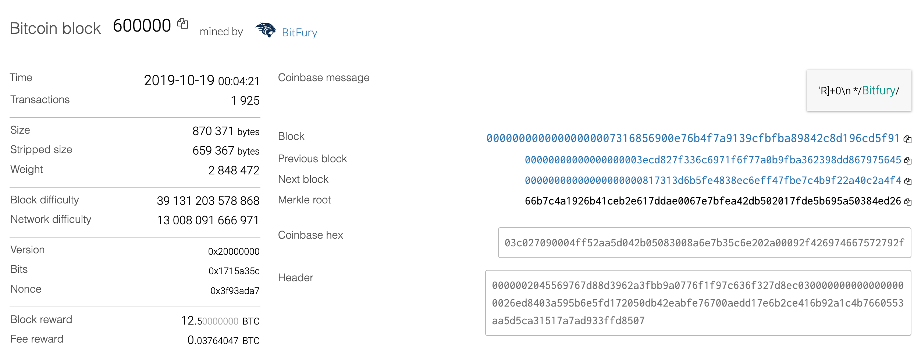
Example

Slide 16
Where can't we use Hash Pointers
Data Structures without explicit pointers: like Arrays.
Data structures which can includes cycles => there is no starting points for hashes

Slide 17
BLOCKCHAIN
Hashing in depth
Pr. TMIMI Mehdi

